Slide 1
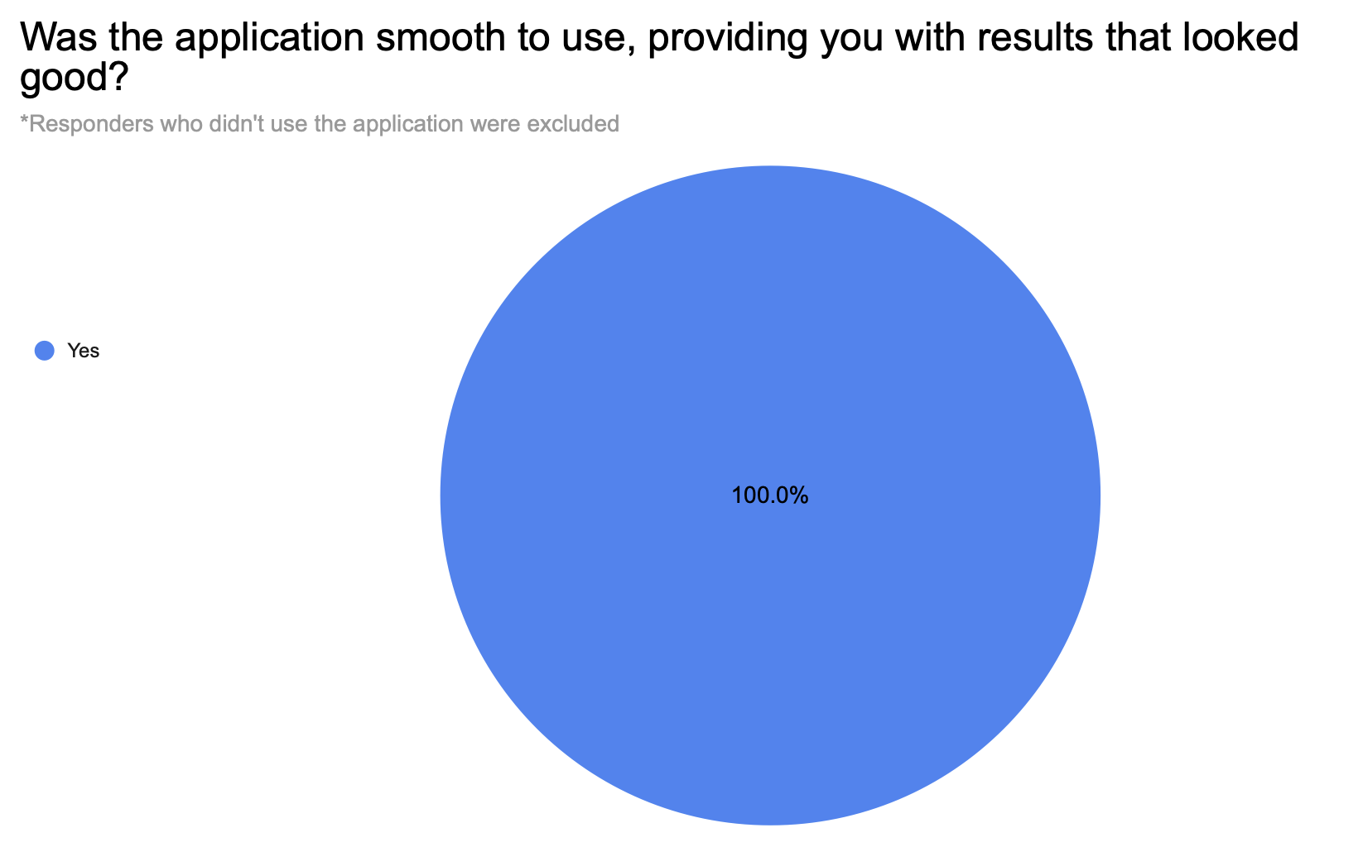
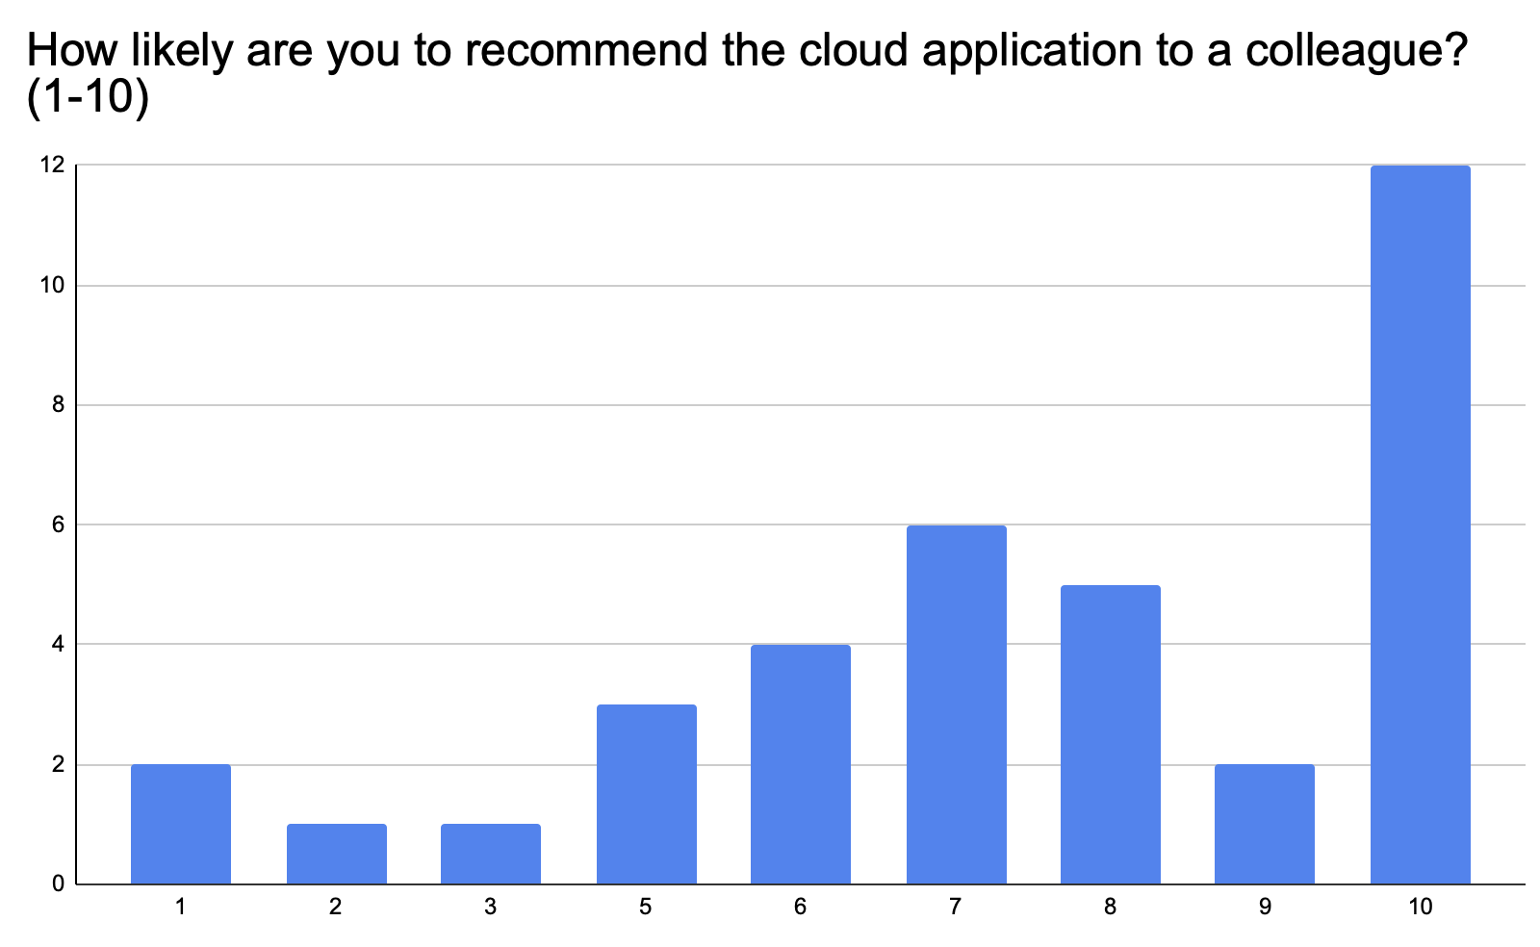
Overview and General Satisfaction
Respondents found the concept & usage of NiChart clear.
Users who tested the application reported a smooth experience and satisfactory results.
High likelihood of recommending the application to colleagues, with scores frequently at or above 8 out of 10.

Slide 2
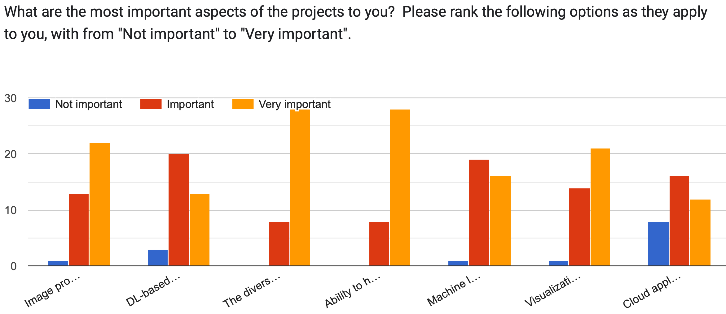
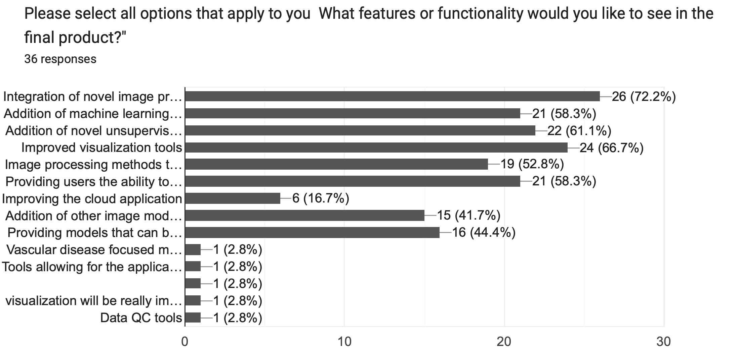
Engagement and Feedback
Varied interest in components like image processing methods and machine learning applications.
Significant portion of users willing to provide detailed feedback.
Valuable suggestions and comments, highlighting improvement areas and expressing appreciation.

